Slide 1
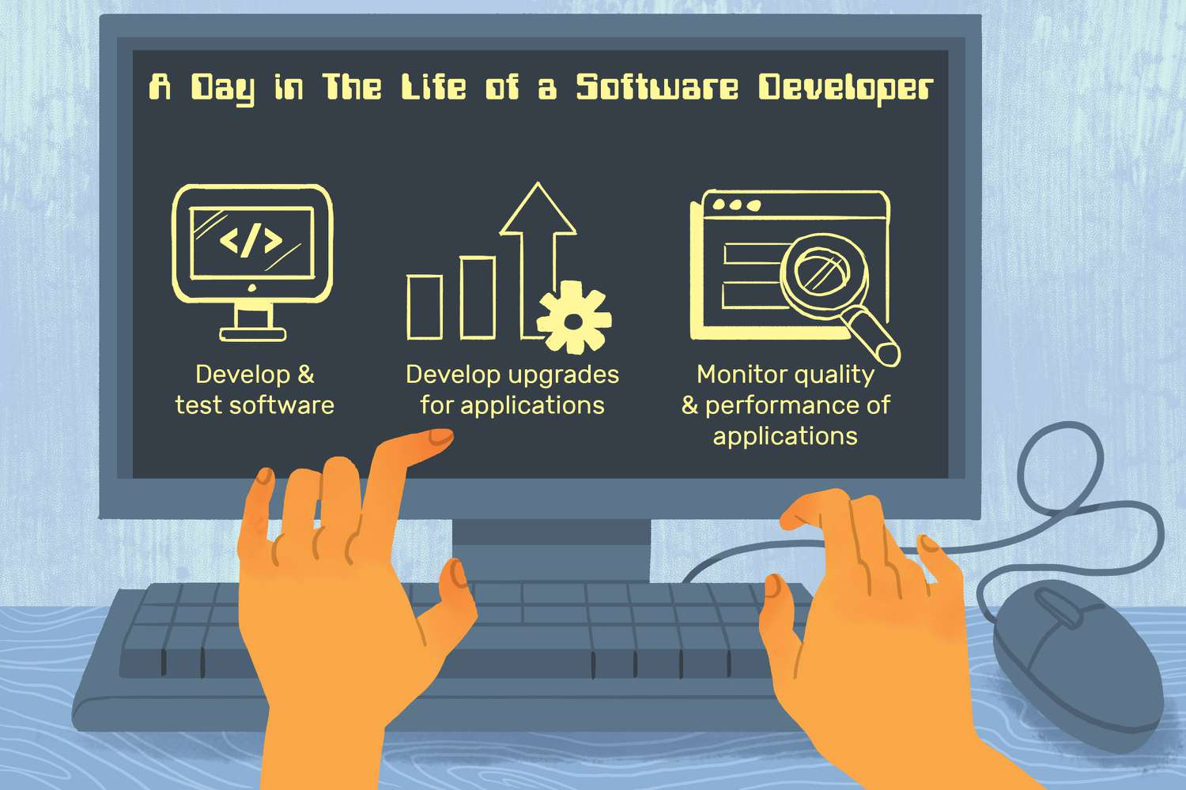

Project Architecture
Clean Architecture
N-Layer
Vertical Slice Architecture
Or Whatever solves your business

Slide 2




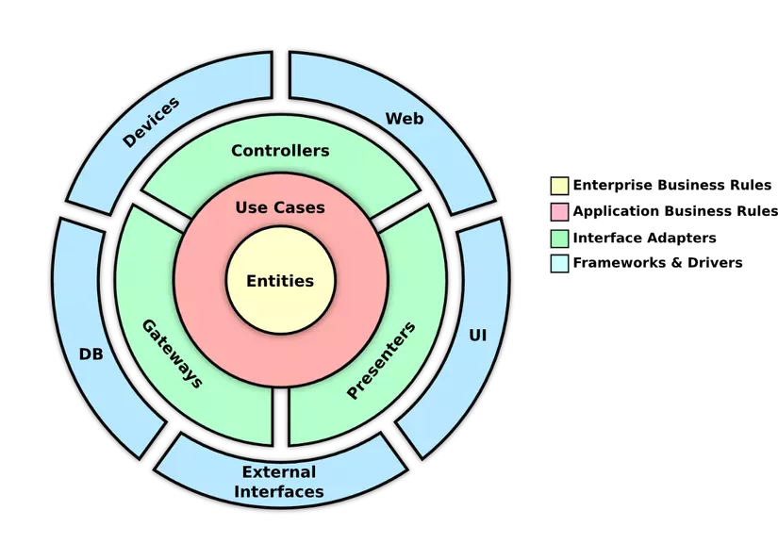
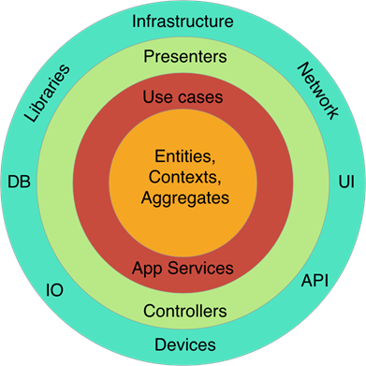






Hi, My name is Alex Nguyen
I’m proficient in
Clean Architecture
DDD

Slide 3
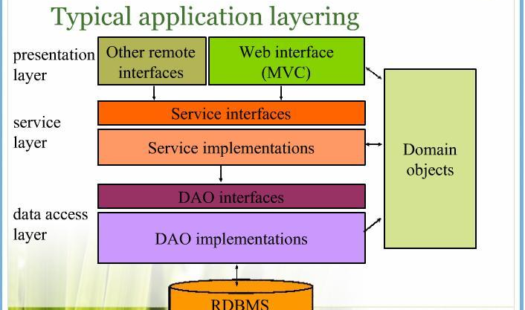
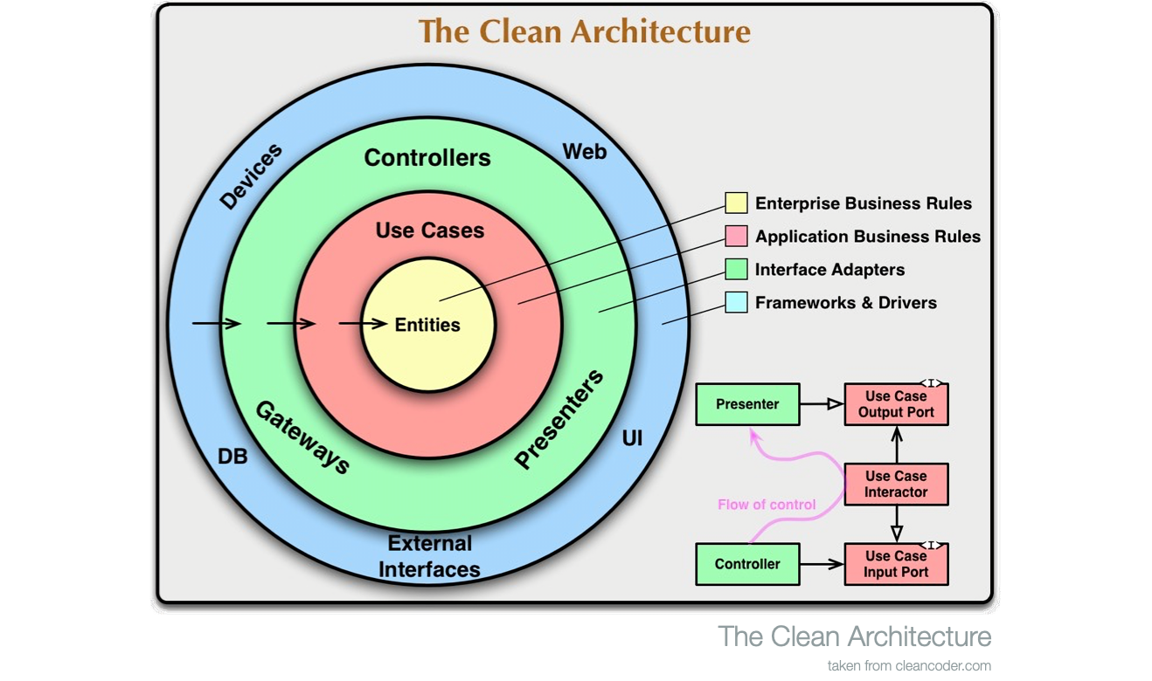
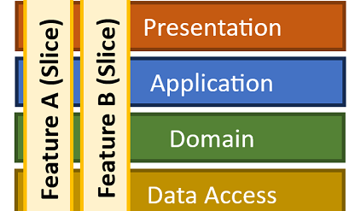
Agenda
N-Layer Architecture
Clean Architecture
Vertical Slice Architecture
Microservices with vertical slice

Slide 4
What are there?
N-Layer
Clean Architecurer
Verticel slice
Micro services
CQRS
DDD
Serverless
TDD
Hexagonal
BDD
Event-Driven

Slide 5
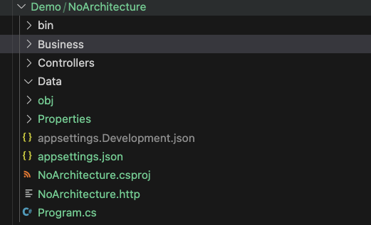

No Architecture
Client
Pros
Little or No Abstraction
Easy & quickly to build from nothing to deploy.
Potential for performance due to tight coupling & less abstraction.
Request
Web Api
Presentation
Business logic
Cons
System expansion invariably leads to increased development costs.
Difficult for multiple team
Difficult for testing
Break or impact the whole system due to technology change.
System logic
use
Database

Slide 6
N-Layer

Slide 7
Clean Architecture

Slide 8
Vertical slice

Slide 9
Your Architecture

Slide 10

Pillars of Success
Domain
SoC (Separation of Concerns)
Maintainability
Testability

Slide 11
Thank you
chuong.nguyen22@logixtek.com
alex.nguyenxl@gmail.com
https://www.linkedin.com/in/alex-nguyen-166981100/

